Slide 1
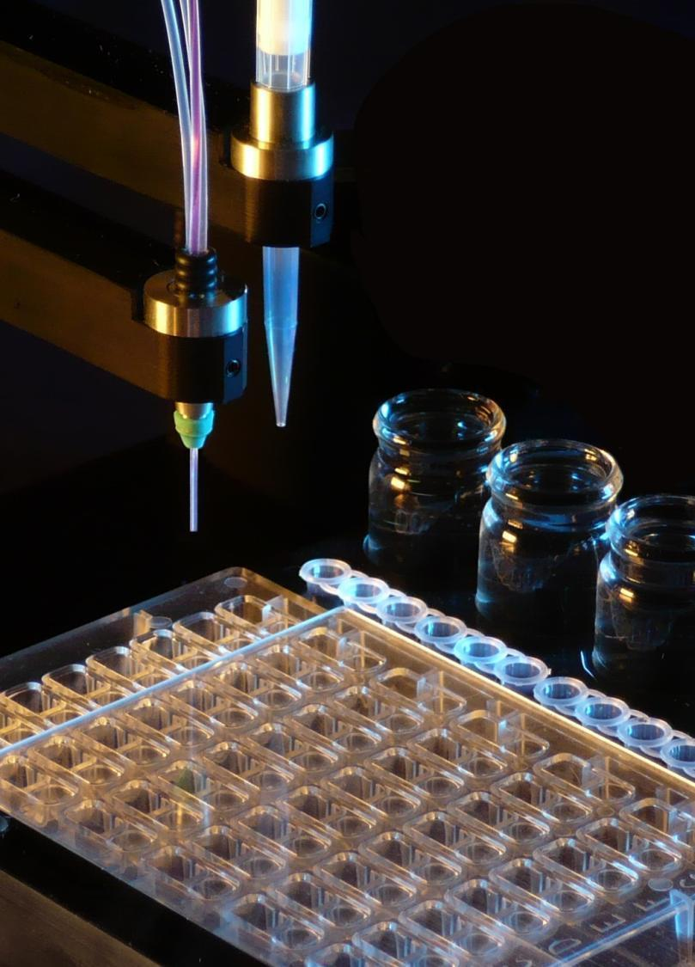
Microseed it!
Introduction to random microseeding
Our work
New experimental design
Patrick Shaw Stewart
Douglas Instruments Ltd

Slide 2
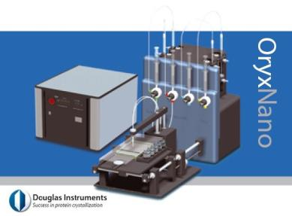
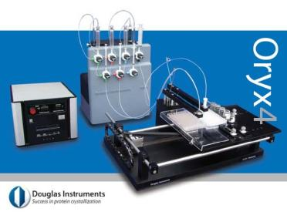
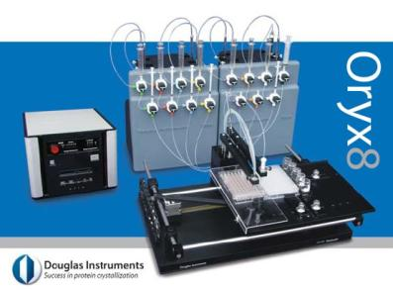
Contact dispensing allows microseeding
Almost no protein / seed
is wasted
Optimization
2-d grid
(7-d Central Composite etc)
Combinatorial script

Slide 3
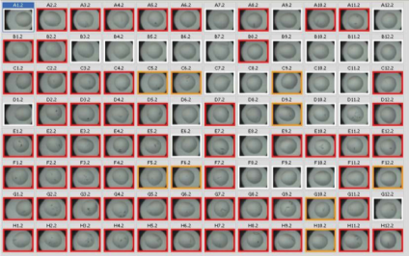
Protein crystallization
Step 1: screening with random solutions that have given crystals before x 96

Slide 4
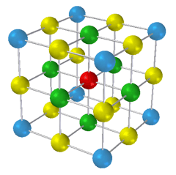
Protein crystallization
Step 1: screening with random solutions that have given crystals before x 96
Step 2: optimization by making small changes

Slide 5
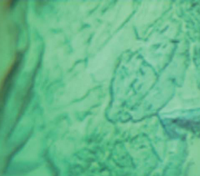
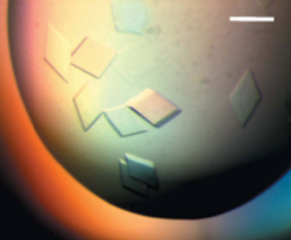
Protein crystallization
Step 1: screening with random solutions that have given crystals before x 96
Step 2: optimization by making small changes

Slide 6
Protein crystallization
Step 1: screening with random solutions that have given crystals before x 96
Step 2: optimization by making small changes
Modify your protein or make a new construct

Slide 7
Protein crystallization
Step 1: screening with random solutions that have given crystals before x 96
Step 1.5: random microseeding
Step 2: optimization by making small changes
Modify your protein or make a new construct

Slide 8
Protein crystallization
Step 1: screening with random solutions that have given crystals before x 96
Step 1.5: random
microseeding
Step 2: optimization by making small changes
Modify your protein or make a new construct

Slide 9
Protein crystallization
Step 1: screening with random solutions that have given crystals before x 96
Step 1.5: random
microseeding
Step 2: optimization by making small changes
Modify your protein or make a new construct
Easy!

Slide 10
Case study – Galina Obmolova, Tom Malia et al,
Acta Cryst (2010) D66, 927 - 933
IL-13/C836
mouse antibody
IL-13/H2L6
humanized
IL-13/M1295
affinity-matured
variant

Slide 11
Case study – Obmolova et al, Acta Cryst (2010) D66, 927 - 933
Conventional methods
Complexes:
IL-13/C836
(mouse antibody)
IL-13/H2L6
(humanized
mAb)
IL-13/M1295
(affinity-matured
humanized mAb)
40 residues changed
4 residues changed

Slide 12
Case study – Obmolova et al, Acta Cryst (2010) D66, 927 - 933
Conventional methods
Complexes:
IL-13/C836
(mouse antibody)
192 conditions
IL-13/H2L6
(humanized
mAb)
IL-13/M1295
(affinity-matured
humanized mAb)
No hits
40 residues changed
4 residues changed

Slide 13
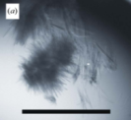
Case study – Obmolova et al, Acta Cryst (2010) D66, 927 - 933
Conventional methods
Complexes:
IL-13/C836
(mouse antibody)
192 conditions
IL-13/H2L6
(humanized
mAb)
192 conditions
IL-13/M1295
(affinity-matured
humanized mAb)
No hits
40 residues changed
One hit
4 residues changed

Slide 14
Case study – Obmolova et al, Acta Cryst (2010) D66, 927 - 933
Conventional methods
Complexes:
IL-13/C836
(mouse antibody)
192 conditions
IL-13/H2L6
(humanized
mAb)
192 conditions
IL-13/M1295
(affinity-matured
humanized mAb)
192 conditions
No hits
40 residues changed
One hit
4 residues changed
No hits

Slide 15
Case study – Obmolova et al, Acta Cryst (2010) D66, 927 - 933
Conventional methods
Complexes:
IL-13/C836
(mouse antibody)
192 conditions
IL-13/H2L6
(humanized
mAb)
192 conditions
IL-13/M1295
(affinity-matured
humanized mAb)
192 conditions
No hits
40 residues changed
One hit
Could not be optimized
4 residues changed
No hits

Slide 16
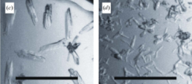
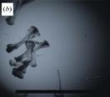
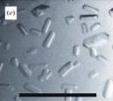
Case study – Obmolova et al, Acta Cryst (2010) D66, 927 - 933
Conventional methods
Random microseeding (rMMS)
Complexes:
IL-13/C836
(mouse antibody)
IL-13/H2L6
(humanized
mAb)
IL-13/M1295
(affinity-matured
humanized mAb)
No hits
40 residues changed
Microseeding
One hit
4 residues changed
No hits

Slide 17
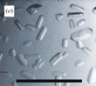
Case study – Obmolova et al, Acta Cryst (2010) D66, 927 - 933
Conventional methods
Random microseeding (rMMS)
Complexes:
IL-13/C836
(mouse antibody)
IL-13/H2L6
(humanized
mAb)
IL-13/M1295
(affinity-matured
humanized mAb)
No hits
40 residues changed
Microseeding
One hit
Optimization
4 residues changed
Both 1.9 Å resolution
orthorhombic P212121
No hits

Slide 18
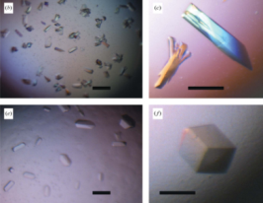
Case study – Obmolova et al, Acta Cryst (2010) D66, 927 - 933
Conventional methods
Random microseeding (rMMS)
Complexes:
IL-13/C836
(mouse antibody)
IL-13/H2L6
(humanized
mAb)
IL-13/M1295
(affinity-matured
humanized mAb)
No hits
40 residues changed
Microseeding
One hit
Optimization
4 residues changed
Both 1.9 Å resolution
orthorhombic P212121
No hits
Cross-seeding
2.8 Å res.
P212121

Slide 19
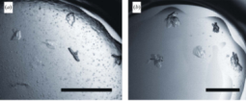
Case study – Obmolova et al, Acta Cryst (2010) D66, 927 - 933
Conventional methods
Random microseeding (rMMS)
Complexes:
IL-13/C836
(mouse antibody)
IL-13/H2L6
(humanized
mAb)
IL-13/M1295
(affinity-matured
humanized mAb)
No hits
40 residues changed
Microseeding
One hit
Cross-seeding
Optimization
4 residues changed
Both 1.9 Å resolution
orthorhombic P212121
No hits
Cross-seeding
2.8 Å res.
P212121

Slide 20
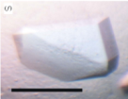
Case study – Obmolova et al, Acta Cryst (2010) D66, 927 - 933
Conventional methods
Random microseeding (rMMS)
Complexes:
IL-13/C836
(mouse antibody)
IL-13/H2L6
(humanized
mAb)
IL-13/M1295
(affinity-matured
humanized mAb)
2.0 Å res.
monoclinic P21
No hits
Optimization
40 residues changed
Microseeding
One hit
Cross-seeding
Optimization
4 residues changed
Both 1.9 Å resolution
orthorhombic P212121
No hits
Cross-seeding
2.8 Å res.
P212121

Slide 21
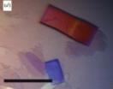
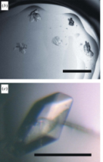
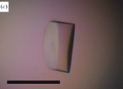
Case study – Obmolova et al, Acta Cryst (2010) D66, 927 - 933
Conventional methods
Random microseeding (rMMS)
Complexes:
IL-13/C836
(mouse antibody)
IL-13/H2L6
(humanized
mAb)
IL-13/M1295
(affinity-matured
humanized mAb)
2.0 Å res.
monoclinic P21
2.0 Å res.
monoclinic P21
No hits
Optimization
40 residues changed
Microseeding
Microseeding
One hit
Cross-seeding
Optimization
4 residues changed
Microseeding
Both 1.9 Å resolution
orthorhombic P212121
No hits
Cross-seeding
2.8 Å res.
P212121

Slide 22
random Microseed Matrix-Screening
http://hamptonresearch.com/documents/ramc/RAMC2011_T11_Obmolova.pdf

Slide 23
Crystals structures obtained by rMMS:
All crystals prepared by Lesley Haire, NIMR, London
N1 Neuraminidase:
3CL0 (His274Tyr–oseltamivir),
3CKZ (His274Tyr–zanamivir),
3CL2 (Asn294Ser–oseltamivir).
Nature 453, 1258-1261 (26 June 2008)
Nbs1 (Nibrin):
3I0M – single crystals with MMS
Cell 139: 100-111 (2009)
SHARPIN
Nucleated on air bubble. Two papers submitted

Slide 24
random Microseed Matrix-Screening
D’Arcy et al. Acta Cryst. (2007). D63. 'An automated microseed matrix-screening method for protein crystallization’

Slide 25
random Microseed Matrix-Screening
D’Arcy et al. Acta Cryst. (2007). D63. 'An automated microseed matrix-screening method for protein crystallization’
Add seed crystals to a random screen

Slide 26
random Microseed Matrix-Screening
D’Arcy et al. Acta Cryst. (2007). D63. 'An automated microseed matrix-screening method for protein crystallization’
Add seed crystals to a random screen
Suspend crushed crystals in the reservoir solution that gave the hits used (“hit solution”)

Slide 27
random Microseed Matrix-Screening
D’Arcy et al. Acta Cryst. (2007). D63. 'An automated microseed matrix-screening method for protein crystallization’
Add seed crystals to a random screen
Suspend crushed crystals in the reservoir solution that gave the hits used (“hit solution”)
Automate!

Slide 28
random Microseed Matrix-Screening
D’Arcy et al. Acta Cryst. (2007). D63. 'An automated microseed matrix-screening method for protein crystallization’
Add seed crystals to a random screen
Suspend crushed crystals in the reservoir solution that gave the hits used (“hit solution”)
Automate!
To get:

Slide 29
random Microseed Matrix-Screening
D’Arcy et al. Acta Cryst. (2007). D63. 'An automated microseed matrix-screening method for protein crystallization’
Add seed crystals to a random screen
Suspend crushed crystals in the reservoir solution that gave the hits used (“hit solution”)
Automate!
To get:
(1) more hits

Slide 30
random Microseed Matrix-Screening
D’Arcy et al. Acta Cryst. (2007). D63. 'An automated microseed matrix-screening method for protein crystallization’
Add seed crystals to a random screen
Suspend crushed crystals in the reservoir solution that gave the hits used (“hit solution”)
Automate!
To get:
(1) more hits
(2) better crystals

Slide 31
Microseeding in screening experiments
Allan D’Arcy
Novartis, Basle
2006 ‘Matrix-seeding script’
3-bore tip
protein
reservoir solution

Slide 32
Microseeding in screening experiments
Allan D’Arcy
Novartis, Basle
2006 ‘Matrix-seeding script’
3-bore tip
protein
reservoir solution
seeds

Slide 33
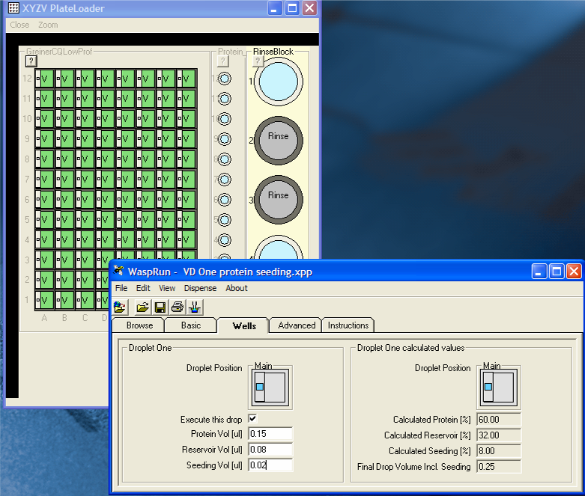
Microseeding in screening experiments
Allan D’Arcy, Novartis, Basle. 2006 ‘Matrix-seeding script’

Slide 34
Matrix seeding volumes:
0.3 µl protein
+ 0.2 µl reservoir solution
+ 0.1 µl seed stock

Slide 35
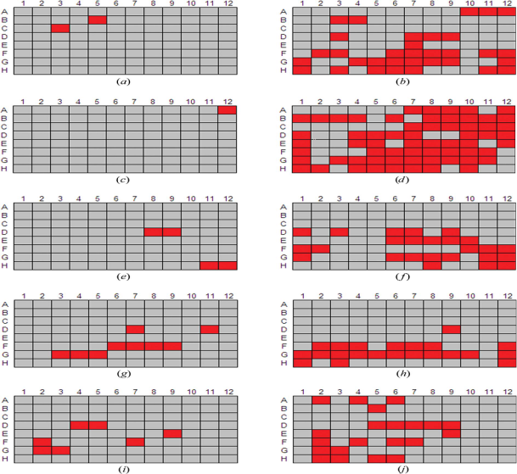
Microseeding in screening experiments
Regular screen | Screen with seeds
MMP12
BVP
USP7
Trypsin
PPE
D’Arcy et al. Acta Cryst. (2007). D63

Slide 36
Microseeding in screening experiments
Regular screen | Screen with seeds
MMP12
BVP
USP7
Trypsin
PPE
Salt
PEG
D’Arcy et al. Acta Cryst. (2007). D63

Slide 37
Microseeding in screening experiments
Regular screen | Screen with seeds
MMP12
BVP
USP7
Trypsin
PPE
Salt
PEG
D’Arcy et al. Acta Cryst. (2007). D63

Slide 38
Microseeding in screening experiments
Regular screen | Screen with seeds
MMP12
BVP
USP7
Trypsin
PPE
D’Arcy et al. Acta Cryst. (2007). D63

Slide 39
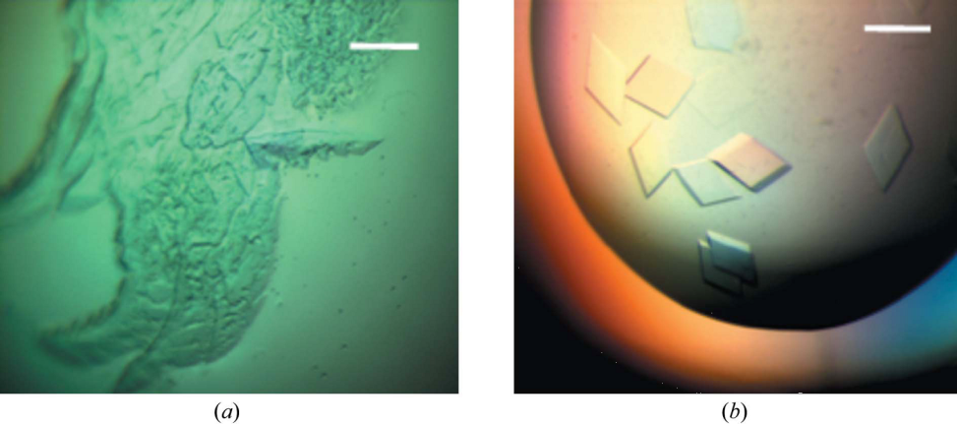
Microseeding in screening experiments
USP7 crystals used for seeds grown in 30% PEG 3350, 100 mM HEPES pH 7.0
USP7 crystals after seeding in 20% PEG 3350, 200 mM magnesium hexahydrate
D’Arcy et al. Acta Cryst. (2007). D63

Slide 40
random Microseed Matrix-Screening (rMMS)
“rMMS”
D’Arcy et al. Acta Cryst. (2007). D63. 'An automated microseed matrix-screening method for protein crystallization’

Slide 41
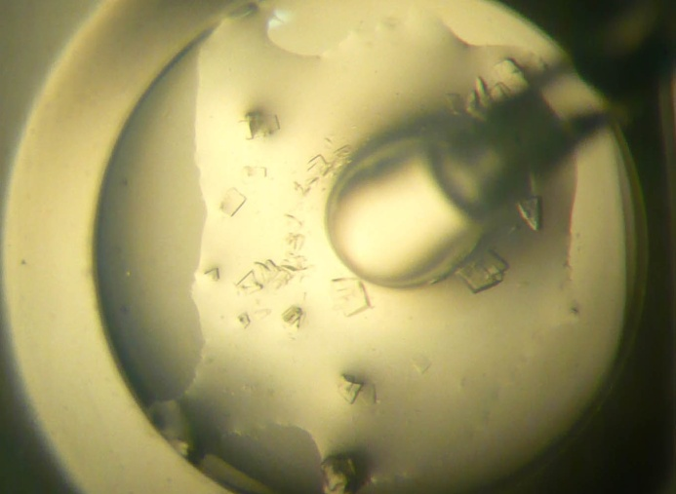
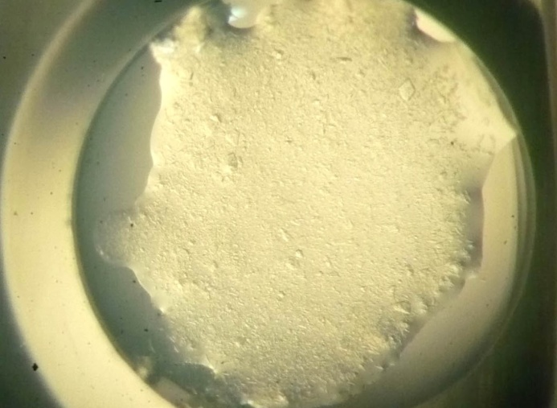
How to make the seed stock
See www.douglas.co.uk/mms.com or sheet
Break crystals with a probe
Place contents of well in 50 μl of reservoir solution
Vortex with Hampton “Seed Bead”
Make a dilution series immediately
Freeze
Look after your seeds!

Slide 42
Phase diagram of a protein
precipitate
[Protein]
nucleation
metastable zone
clear
[Precipitant]

Slide 43
Membrane proteins
Christine Oswald (Goethe University of Frankfurt) pointed out that the seeds may dissolve if there is not enough detergent
We recommend crushing the crystals and harvesting several large drops without dilution
Only 1.5 µl of seed stock are needed to fill a whole plate with (the right kind of) contact dispenser
See http://www.douglas.co.uk/MMS_proc.htm

Slide 44
Matrix seeding volumes:
0.3 µl protein
+ 0.2 µl reservoir solution
+ 0.1 µl seed stock

Slide 45
Matrix seeding volumes:
0.3 µl protein
+ 0.2 µl reservoir solution
+ 0.1 µl seed stock
E.g. Membrane proteins:
0.3 µl protein
+ 0.29 µl reservoir solution
+ 0.01 µl seed stock

Slide 46
Membrane proteins
Collaboration with MPL at Diamond
Several proteins showed no improvement
One protein showed a different crystal form in the same conditions
One protein showed greatly improved diffraction

Slide 47
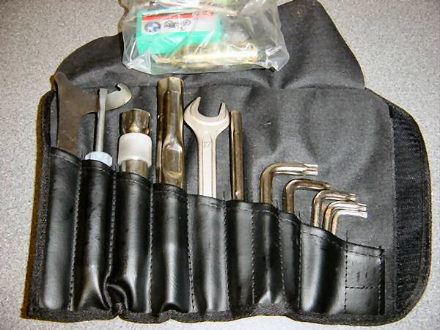
Microseeding toolkit

Slide 48
If you want to know more:
Patrick D. Shaw Stewart, Stefan A. Kolek, Richard A. Briggs, Naomi E. Chayen and Peter F.M. Baldock. “Random Microseeding: A Theoretical and Practical Exploration of Seed Stability and Seeding Techniques for Successful Protein Crystallization”
Crystal Growth and Design, 2011, 11 (8), p3432.
On-line at http://pubs.acs.org/doi/abs/10.1021/cg2001442

Slide 49
Microseeding
Opticryst – a consortium of European institutions and companies aiming to improve crystal optimization. 2007 – 2010.

Slide 50
Microseeding
Opticryst – a consortium of European institutions and companies aiming to improve crystal optimization. 2007 – 2010.
We decided to look into microseeding, especially the stability of seeds.

Slide 51
Microseeding
Opticryst – a consortium of European institutions and companies aiming to improve crystal optimization. 2007 – 2010.

Slide 52
Microseeding
Opticryst – a consortium of European institutions and companies aiming to improve crystal optimization. 2007 – 2010.
Stefan set up 30,000
drops and estimated
the number of crystals
In 15,000 drops!

Slide 53
random Microseed Matrix-Screening
Our questions: | Take-home practical suggestions:
(1) How can we get as many hits as possible?
(2) How stable are the seed stocks?
(3) Is “preseeding” the protein stock helpful?
(4) How can we avoid salt crystals?
(5) How can we get more diverse crystals?
(6) How can we stabilize protein complexes, including heavy atom, small molecule and peptide derivatives ?
(7) Can we harvest seed crystals from microfluidic devices?
(8) What can you do if you have no crystals?

Slide 54
Protein | Source | Concentration
Glucose Isomerase | Hampton Research | 33 mg/ml
Hemoglobin | Sigma Aldrich | 60 mg/ml
Thaumatin | Sigma Aldrich | 30 mg/ml
Thermolysin | Sigma Aldrich | 15 mg/ml
Trypsin | Sigma Aldrich | 30 mg/ml
Xylanase | Macro Crystal | 36 mg/ml

Slide 55
“Receptive” conditions
Conditions where:
crystals don’t grow without seeds in four drops, but
crystals grow in at least three out of four drops with seeds.

Slide 56
“Receptive” conditions
Conditions where:
crystals don’t grow without seeds in four drops, but
crystals grow in at least three out of four drops with seeds.
25 receptive conditions were found

Slide 57
1 | Glucose Isomerase | JCSG+ | 2-2 | 2 M (NH4)2SO4, 0.2 M NaCl, 0.1 M Na MES, PH 6.5
2 | Glucose Isomerase | JCSG+ | 2-43 | 25%(w/v) PEG 3350, 0.2 M (NH4)2SO4, 0.1 M bis-tris
3 | Hemoglobin | JCSG+ | 2-25 | 30%(w/v) Jeffamine ED-2001, 0.1 M Na HEPES, PH 7.0
4 | Hemoglobin | JCSG+ | 2-33 | 30%(w/v) PEG 2000 MME, K thiocyanate
5 | Hemoglobin | JCSG+ | 2-34 | 30%(w/v) PEG 2000 MME, K bromide
6 | Hemoglobin | JCSG+ | 2-44 | 25%(w/v) PEG 3350, 0.2 M NaCl, 0.1 M bis-tris, PH 5.5
7 | Thaumatin | Structure screen 1 | 7 | 30%(w/v) PEG 4K, 0.2 M ammonium acetate, 0.1M Na citrate, PH 5.6
8 | Thaumatin | Structure screen 1 | 9 | 20%(v/v) IPA, 20%(w/v) PEG 4K, 0.1 M Na citrate, PH 5.6
9 | Thaumatin | Structure screen 1 | 14 | 30%(w/v) PEG 8K, 0.2 M (NH4)2SO4, 0.1 M Na cacodylate, PH 6.5
10 | Thaumatin | Structure screen 1 | 15 | 20%(w/v) PEG 8K, 0.2M magnesium acetate, 0.1 M Na cacodylate, PH6.5
11 | Thaumatin | Structure screen 1 | 32 | 2 M (NH4)2SO4, 0.1 M tris, PH 8.5
12 | Thaumatin | Jena Bioscience Membrane screen3 | D5 | 1.5 M Li2SO4, 0.1 M Na HEPES, PH 7.5
13 | Thermolysin | JCSG+ (2:1 water) | 1-2 | 20%(w/v) PEG 3K, 0.1 M Na citrate, PH 5.5
14 | Thermolysin | JCSG+ (2:1 water) | 1-21 | 20%(w/v) PEG 6k, 0.1 M citric acid, PH 5.0
15 | Thermolysin | JCSG+ (2:1 water) | 2-18 | 10%(v/v) MPD, 0.1 M bicine, PH 9.0
16 | Thermolysin | JCSG+ (2:1 water) | 2-19 | 0.8 M succinic acid, PH 7.0
17 | Thermolysin | JCSG+ (2:1 water) | 2-21 | 2.4 M Na malonate, PH 7.0
18 | Thermolysin | JCSG+ (2:1 water) | 2-22 | 0.5%(w/v) Jeffamine ED-2001, 1.1 M Na malonate, 0.1 M Na HEPES, PH 7.0
19 | Trypsin | Jena Bioscience Membrane screen3 | D3 | 1.5 M NaCl, 0.1M Na acetate, PH 4.6
20 | Trypsin | Jena Bioscience Membrane screen3 | D3 | 1.5 M NaCl, 0.1M Na acetate, PH 4.6
21 | Trypsin | Jena Bioscience Membrane screen3 | D6 | 2 M NaCl, 0.1 M Na citrate
22 | Trypsin | Jena Bioscience Membrane screen3 | D6 | 2 M NaCl, 0.1 M Na citrate
23 | Xylanase | Structure screen 1 | 32 | 2 M (NH4)2SO4, 0.1 M tris, PH 8.5
24 | Xylanase | Structure screen 1 | 37 | 30%(w/v) PEG 4K, 0.2 M Na acetate, 0.1 M tris, PH 8.5
25 | Xylanase | Structure screen 1 | 45 | 4 M Na formate
26 | Xylanase | Jena Bioscience Membrane screen3 | B5 | 3.5 M (NH4)2SO4, 0.25M NaCl, 50mM Na/K phosphate, PH 7.5
27 | Xylanase | Jena Bioscience Membrane screen3 | D4 | 1.5 M K phosphate, PH 7.0

Slide 58
1 | Glucose Isomerase | JCSG+ | 2-2 | 2 M (NH4)2SO4, 0.2 M NaCl, 0.1 M Na MES, PH 6.5
2 | Glucose Isomerase | JCSG+ | 2-43 | 25%(w/v) PEG 3350, 0.2 M (NH4)2SO4, 0.1 M bis-tris
3 | Hemoglobin | JCSG+ | 2-25 | 30%(w/v) Jeffamine ED-2001, 0.1 M Na HEPES, PH 7.0
4 | Hemoglobin | JCSG+ | 2-33 | 30%(w/v) PEG 2000 MME, K thiocyanate
5 | Hemoglobin | JCSG+ | 2-34 | 30%(w/v) PEG 2000 MME, K bromide
6 | Hemoglobin | JCSG+ | 2-44 | 25%(w/v) PEG 3350, 0.2 M NaCl, 0.1 M bis-tris, PH 5.5
7 | Thaumatin | Structure screen 1 | 7 | 30%(w/v) PEG 4K, 0.2 M ammonium acetate, 0.1M Na citrate, PH 5.6
8 | Thaumatin | Structure screen 1 | 9 | 20%(v/v) IPA, 20%(w/v) PEG 4K, 0.1 M Na citrate, PH 5.6
9 | Thaumatin | Structure screen 1 | 14 | 30%(w/v) PEG 8K, 0.2 M (NH4)2SO4, 0.1 M Na cacodylate, PH 6.5
10 | Thaumatin | Structure screen 1 | 15 | 20%(w/v) PEG 8K, 0.2M magnesium acetate, 0.1 M Na cacodylate, PH6.5
11 | Thaumatin | Structure screen 1 | 32 | 2 M (NH4)2SO4, 0.1 M tris, PH 8.5
12 | Thaumatin | Jena Bioscience Membrane screen3 | D5 | 1.5 M Li2SO4, 0.1 M Na HEPES, PH 7.5
13 | Thermolysin | JCSG+ (2:1 water) | 1-2 | 20%(w/v) PEG 3K, 0.1 M Na citrate, PH 5.5
14 | Thermolysin | JCSG+ (2:1 water) | 1-21 | 20%(w/v) PEG 6k, 0.1 M citric acid, PH 5.0
15 | Thermolysin | JCSG+ (2:1 water) | 2-18 | 10%(v/v) MPD, 0.1 M bicine, PH 9.0
16 | Thermolysin | JCSG+ (2:1 water) | 2-19 | 0.8 M succinic acid, PH 7.0
17 | Thermolysin | JCSG+ (2:1 water) | 2-21 | 2.4 M Na malonate, PH 7.0
18 | Thermolysin | JCSG+ (2:1 water) | 2-22 | 0.5%(w/v) Jeffamine ED-2001, 1.1 M Na malonate, 0.1 M Na HEPES, PH 7.0
19 | Trypsin | Jena Bioscience Membrane screen3 | D3 | 1.5 M NaCl, 0.1M Na acetate, PH 4.6
20 | Trypsin | Jena Bioscience Membrane screen3 | D3 | 1.5 M NaCl, 0.1M Na acetate, PH 4.6
21 | Trypsin | Jena Bioscience Membrane screen3 | D6 | 2 M NaCl, 0.1 M Na citrate
22 | Trypsin | Jena Bioscience Membrane screen3 | D6 | 2 M NaCl, 0.1 M Na citrate
23 | Xylanase | Structure screen 1 | 32 | 2 M (NH4)2SO4, 0.1 M tris, PH 8.5
24 | Xylanase | Structure screen 1 | 37 | 30%(w/v) PEG 4K, 0.2 M Na acetate, 0.1 M tris, PH 8.5
25 | Xylanase | Structure screen 1 | 45 | 4 M Na formate
26 | Xylanase | Jena Bioscience Membrane screen3 | B5 | 3.5 M (NH4)2SO4, 0.25M NaCl, 50mM Na/K phosphate, PH 7.5
27 | Xylanase | Jena Bioscience Membrane screen3 | D4 | 1.5 M K phosphate, PH 7.0
“Hit Solution”

Slide 59
Do any other precipitants work better than the Hit Solution for suspending seed crystals?

Slide 60
Focusing on “pregnant” conditions
(a)
(b)
(c)

Slide 61
random Microseed Matrix-Screening
Our questions: | Take-home practical suggestions:
(1) How can we get as many hits as possible? | Stick to the ‘hit solution’ for suspending seed crystals for routine rMMS
(2) How stable are the seed stocks?
(3) Is “preseeding” the protein stock helpful?
(4) How can we avoid salt crystals?
(5) How can we get more diverse crystals?
(6) How can we stabilize protein complexes, including heavy atom, small molecule and peptide derivatives ?
(7) Can we harvest seed crystals from microfluidic devices?
(8) What can you do if you have no crystals?

Slide 62
Phase diagram of a protein
Protein stock
precipitate
[Protein]
nucleation
metastable zone
clear
Seed stock
[Precipitant]
Reservoir stock

Slide 63
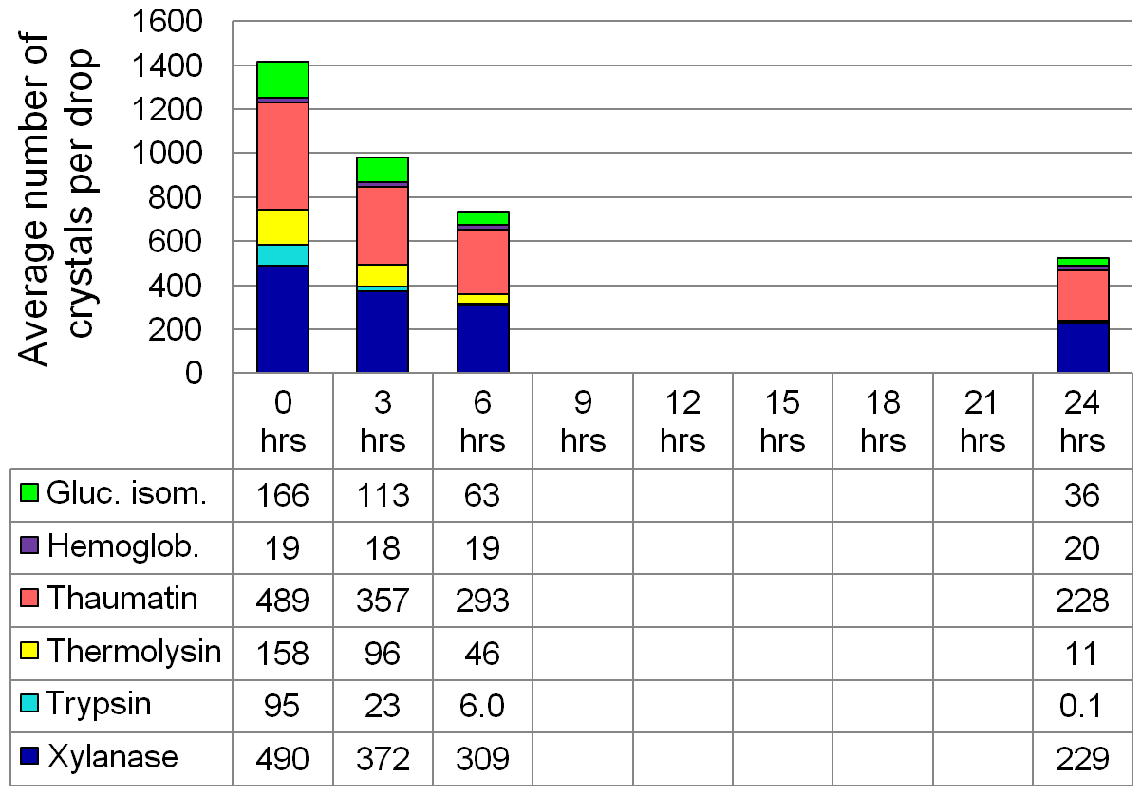

Slide 64
random Microseed Matrix-Screening
Our questions: | Take-home practical suggestions:
(1) How can we get as many hits as possible? | Stick to the ‘hit solution’ for suspending seed crystals for routine rMMS
(2) How stable are the seed stocks? | Not completely stable so use your seed stock quickly, then freeze. Or cross-link.
(3) Is “preseeding” the protein stock helpful?
(4) How can we avoid salt crystals?
(5) How can we get more diverse crystals?
(6) How can we stabilize protein complexes, including heavy atom, small molecule and peptide derivatives ?
(7) Can we harvest seed crystals from microfluidic devices?
(8) What can you do if you have no crystals?

Slide 65
random Microseed Matrix-Screening
Our questions: | Take-home practical suggestions:
(1) How can we get as many hits as possible? | Stick to the ‘hit solution’ for suspending seed crystals for routine rMMS
(2) How stable are the seed stocks? | Not completely stable so use your seed stock quickly, then freeze. Or cross-link.
(3) Is “preseeding” the protein stock helpful? | Please read the paper!
(4) How can we avoid salt crystals? | Please read the paper!
(5) How can we get more diverse crystals? | Please read the paper!
(6) How can we stabilize protein complexes, including heavy atom, small molecule and peptide derivatives ?
(7) Can we harvest seed crystals from microfluidic devices? | Please read the paper!
(8) What can you do if you have no crystals? | Please read the paper!

Slide 66
random Microseed Matrix-Screening
Our questions: | Take-home practical suggestions:
(1) How can we get as many hits as possible? | Stick to the ‘hit solution’ for suspending seed crystals for routine rMMS
(2) How stable are the seed stocks? | Not completely stable so use your seed stock quickly, then freeze. Or cross-link.
(3) Is “preseeding” the protein stock helpful? | Please read the paper!
(4) How can we avoid salt crystals? | Please read the paper!
(5) How can we get more diverse crystals? | Please read the paper!
(6) How can we stabilize protein complexes, including heavy atom, small molecule and peptide derivatives ?
(7) Can we harvest seed crystals from microfluidic devices? | Please read the paper!
(8) What can you do if you have no crystals? | Please read the paper!

Slide 67
Suggested by Lesley Haire, National Institute for Medical Research

Slide 68
Cross-seeding
A natural approach, especially when you are adding something small e.g. a peptide or nucleic acid
Complex
Uncomplexed protein crystals

Slide 69
Cross-seeding
You don’t have to match the unit cell, only one of the structural planes of the crystals

Slide 70
Cross-seeding
You don’t have to match the unit cell, only one of the structural planes of the crystals

Slide 71
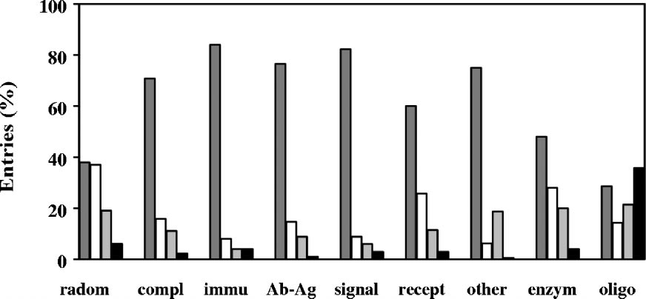
Crystallizing complexes
Radaev and Sun. Crystallization of protein-protein complexes.
J. Appl. Cryst. (2002). 35, 674-676
PEG / (NH4)2SO4 / other salts / organic solvents (including 2-propanol, MPD, ethanol)
Random samples, all protein-protein complexes included in this survey, immune complexes, antibody-antigen complexes, signal transduction complexes, receptor and ligand complexes, miscellaneous protein-protein complexes, enzyme related complexes, oligomeric protein complexes

Slide 72
What can we replace the Hit Solution with?
(a)
(b)
(c)

Slide 73
random Microseed Matrix-Screening
Our questions: | Take-home practical suggestions:
(1) How can we get as many hits as possible? | Stick to the ‘hit solution’ for suspending seed crystals for routine rMMS
(2) How stable are the seed stocks? | Not completely stable so use your seed stock quickly, then freeze. Or cross-link.
(3) Is “preseeding” the protein stock helpful? | Please read the paper!
(4) How can we avoid salt crystals? | Please read the paper!
(5) How can we get more diverse crystals? | Please read the paper!
(6) How can we stabilize protein complexes, including heavy atom, small molecule and peptide derivatives ? | Avoid high salt in your seed stock;
(7) Can we harvest seed crystals from microfluidic devices? | Please read the paper!
(8) What can you do if you have no crystals? | Please read the paper!

Slide 74
Can we predict which solutions the seed crystals will be stable in?

Slide 75
Focusing on “pregnant” conditions
(a)
(b)
(c)

Slide 76
Appearance of crystals after incubation for one day
Wick away the mother liquor
Add 10 µl of the solution to be tested
Incubate for 5 minutes
Wick away the solution added
Add another 10 µl of the solution to be tested
Incubate overnight
Look at the crystals, comparing photos of before and after

Slide 77
Appearance of crystals after incubation for one day
Protein | Crystals in Hit Sol. | Crystals in Isopropanol | Crystals in PEG 600 | Crystals in Amm.sul. | Crystals in NaCl | Crystals in protein stock
Gluc. Isom. | OK | Cracked | Shattered | Cracked | Dissolved | Dissolved
Hemoglobin | OK | Cracked | OK | Dissolved | Dissolved | Dissolved
Thaumatin Thermolysin | OK OK | Cracked OK | OK Shattered | OK OK | OK Dissolved | Grew Grew
Trypsin Xylanase | OK OK | OK OK | Dissolved Cracked | OK OK | OK OK | Dissolved Dissolved

Slide 78
Try to find a solution that both the seed crystals and the complex are stable in
Investigate stability of complex with isothermal calorimetry, fluorescence anisotropy, thermal shift assay etc.
Test stability of seed crystals by incubation of uncrushed crystals in the suggested solution for 1 day

Slide 79
random Microseed Matrix-Screening
Our questions: | Take-home practical suggestions:
(1) How can we get as many hits as possible? | Stick to the ‘hit solution’ for suspending seed crystals for routine rMMS
(2) How stable are the seed stocks? | Not completely stable so use your seed stock quickly, then freeze. Or cross-link.
(3) Is “preseeding” the protein stock helpful? | Please read the paper!
(4) How can we avoid salt crystals? | Please read the paper!
(5) How can we get more diverse crystals? | Please read the paper!
(6) How can we stabilize protein complexes, including heavy atom, small molecule and peptide derivatives ? | Avoid high salt in your seed stock; remove ingredients .... test by incubation for 1 day
(7) Can we harvest seed crystals from microfluidic devices? | Please read the paper!
(8) What can you do if you have no crystals? | Please read the paper!

Slide 80
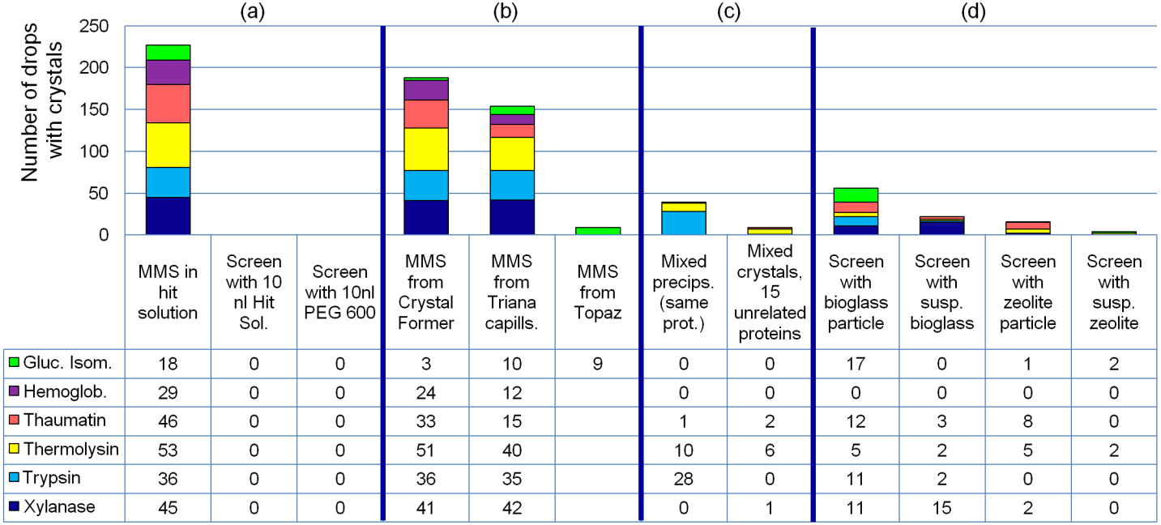
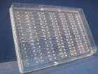
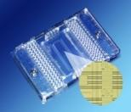
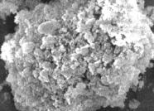
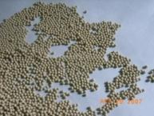
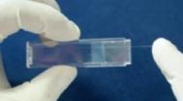

Slide 81
Soaking experiments
You need a good supply of wells with about 5 crystals per drop
Seeding with diluted seed stock is “the only reliable way” to achieve this

Slide 82
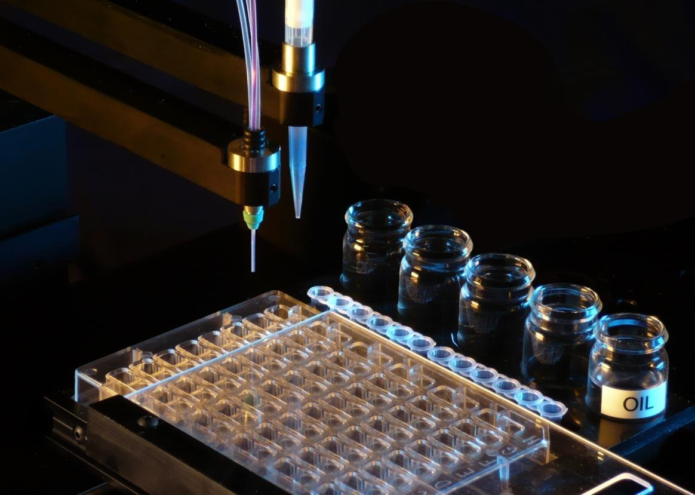
New “combinatorial” experimental design
TTT

Slide 83
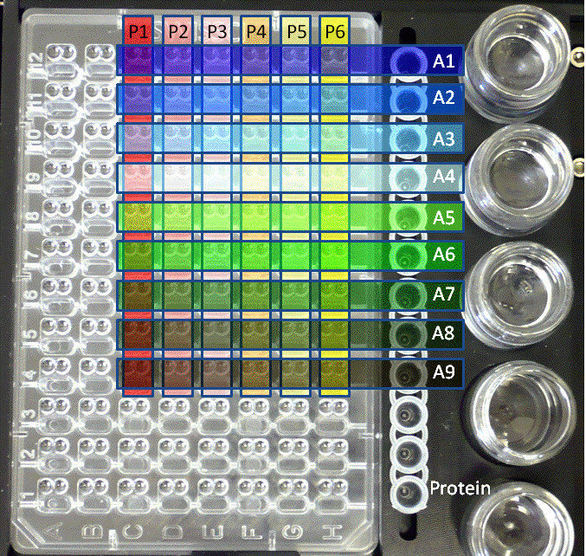
New “combinatorial” experimental design
Microseeding:
A1: 100% seed stock
A2: 25% seed stock
A3: 6.3% seed stock
A4: 1.6% seed stock
A5: 0.4% seed stock
A6: 0.1% seed stock
A7: 0.02% seed stock
A8: 0.006% seed stock
A9: 0.002% seed stock

Slide 84
New “combinatorial” experimental design

Slide 85
New “combinatorial” experimental design
Or test up to 12 inhibitors or ligands

Slide 86
New “combinatorial” experimental design
A third use -

Slide 87
New “combinatorial” experimental design
PEG4000, MgCl2, citrate pH5
PEG600, CaCl2, TRIS pH8
NaCl, imidazole pH6

Slide 88
New “combinatorial” experimental design
Original hits:
PEG4000, MgCl2, citrate pH5
PEG600, CaCl2, TRIS pH8
NaCl, imidazole pH6
P1, P2: PEG4000
P3, P4: PEG600
P5, P6: NaCl
A1: MgCl2
A2: MgCl2 + Citrate
A3: CaCl2 etc
.
.
.

Slide 89
New “combinatorial” experimental design
Original hits:
PEG4000, MgCl2, Citrate pH5
PEG600, CaCl2, TRIS pH8
NaCl, Imidazole pH6
P1, P2: PEG4000
P3, P4: PEG600
P5, P6: NaCl
A1: MgCl2
A2: MgCl2 + Citrate
A3: CaCl2 etc
Ingredients can be reshuffled!
This is equivalent to a “targeted screen”. Yellow indicates the best combination above.

Slide 90
New “combinatorial” experimental design
PEG4000, MgCl2, citrate pH5
PEG600, CaCl2, TRIS pH8
NaCl, imidazole pH6
PEG 4000, CaCl2, imidazole pH6

Slide 91
rMMS: comments by Allan D’Arcy
Freeze your seed stock – then you can always reproduce your crystals (even years later)
rMMS greatly reduces the need for crystal optimization
So always do it – unless you can solve the structure with crystals taken straight from your initial screens

Slide 92
Thank you for listening!

Slide 93
Thank you for listening!
Microseeding paper:
Shaw Stewart et al., Cryst. Growth Des., 2011, 11 (8), p3432.

Slide 94
Crosslinking seed crystals after crushing
Protein | Seeds in Hit Sol | Seeds in PEG 600 | X-linked seeds in PEG, used immediately | X-linked seeds in PEG, 1wk 20°C | Seeds in NaCl | X-linked seeds in NaCl, used immediately | X-linked seeds in NaCl, 1wk 20°C
Gluc. isom. | 18 | 1 | 9 | 9 | 0 | 9 | 9
Hemoglobin | 10 | 10 | 7 | 0 | 0 | 0 | 0
Trypsin | 36 | 36 | 36 | 13 | 33 | 36 | 25

Slide 95
Scaling up
100 + 100 nl
1 + 1 µl

Slide 96
Scaling up
100 + 100 nl
1 + 1 μl
Tartan indicates precipitation
(my family is Scottish!)

Slide 97
Scaling up
High surface to volume ratio
Low surface to volume ratio
More protein is lost at the air/liquid interface
Equilibration is faster

Slide 98
Scaling up
Try 200 nl (protein) + 100 nl (reservoir solution)
Scales up to 1 + 1 μl (Heather Ringrose, Pfizer)

Slide 99
Scaling up
100 nl (protein) + 100 nl (reservoir solution)
Equilibrates faster
Scales up to 0.5 + 1 μl
(Heather Ringrose, Pfizer)
Increase the salt by 50 – 100%

